Slide 1
Course Introduction
Welcome to ENGL 3110

Slide 2
Please Be Patient!
Good things to do while everyone gets here.
  Explore Canvas
  Look at the Course Schedule
  Look over the Syllabus
  Explore the “Resources” on the front page of Canvas

Slide 3
House Keeping
Check gradebook. Can you see…
  Your attendance at the top
  Your total points at the bottom
  Your 10 points for the homework
    Take a moment to look at my feedback on the homework

Slide 4
House Keeping
Unit One Schedule
  Homework and Quizzes until Sept 19th
  Study Guide - Sept 22nd
    Due as homework
  Exam – Sept 24th
    Take in class (open note, open book)

Slide 5
Refresher
Language is “infinitely generative”
  Sentences can be infinitely long and still grammatically correct
Words fall in two categories
  Open Classes (new words can be added all the time)
    Nouns, Verbs, Adjectives, Adverbs
  Closed Classes (relatively fixed list over time)
    Prepositions, Pronouns, Determiners, etc.

Slide 6
Refresher
Core Elements of all Sentences
  Noun (head of a noun phrase - VP)
  Verb (head of a verb phrase - NP)
Open-Class Modifiers
  Adjectives (head of an adjective phrase - AdjP)
    Can modify nouns, prepositional phrases, or words acting as nouns
  Adverbs (head of an adverb phrase - AdvP)
    Can modify verbs, adjectives, whole sentences, or other adverbs

Slide 7
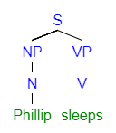
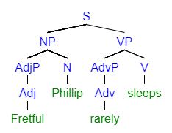
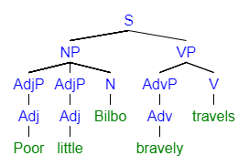
Sample Diagrams

Slide 8
Reading Discussion: Key Concepts
Dialects and Language Standards
  A dialect is a version of a language
    Could be tiny like “Colorado Springs English”
    Could be broader like “Caribbean Englishes”
  No dialect is inherently better or worse than any other.
    All are internally logical
    All are learned and spoken perfectly by native speakers

Slide 9
Reading Discussion: Key Concepts
Some Dialects carry “Social Privilege”
  Typically dialects used by groups in positions of power and privilege
  These are then enforced as the “standard” dialect and other dialects become “non-standard.”
  The prestige difference is often a product of colonialism and oppression
  No dialect is inherently better or worse than any other.
  It is a choice to learn or to use elements of other dialects, but it is a choice with many consequences

Slide 10
Reading Discussion: Key Concepts
Dialect
  Emphasizes geography, class, and race
Speech Community
  Emphasizes culture, identity, and community
Discourse Community
  Emphasizes writing and reading more.
  Emphasizes schools, careers, hobbies, and other “voluntary” groups

Slide 11
Homework Discussion
Exercise 1. p. 1.7
The terms first language and L1 (or sometimes, native language) refer to the language you learned from the people around you from your very early childhood. Many people have more than one L1.

Slide 12
Group Discussion
What is your L1? Do you have more than one?
  What “dialects” of your L1 (or L1s) do you use?
What “language varieties” can you speak or borrow from?
  Dialects, Discourse Communities, or Speech Communities
What are the contexts where you typically use these varieties?
What are the consequences (positive or negative) of using these dialects in other contexts?

Slide 13
Homework Discussion
1.4.1 on page 1.5
This section describes some ways that language science has done harm to minoritized groups of people. Think about what you know about other social sciences (such as anthropology, sociology, psychology), life sciences (physiology, biology, neuroscience, etc.) or physical sciences (geology, physics, chemistry, etc.).

Slide 14
Homework Discussion
1.4.1 on page 1.5
  What are some steps scientists in these fields could take to lessen or even repair these harms?

Slide 15
Homework Discussion
Exercise 1. p. 1.7
Make two scientific observations about your L1. Remember that scientific observations are descriptive, not prescriptive.

Slide 16
Reading Discussion: Key Concepts
Languages Change over Time
  Older is not “better” than new
  Efforts to maintain “purity” are unlikely to make a dent
    Délégation générale à la langue française et aux langues de France
  Trying to enforce standards from the past is a form of prescriptivism
  From a descriptive linguistic perspective, change is not bad. It just is.

Slide 17
Reading Discussion: Key Concepts
- Douglas Rushkoff, 2013
  “Without grammar, we lose the agreed-upon standards about what means what. We lose the ability to communicate when respondents are not actually in the same room speaking to one another. Without grammar, we lose the precision required to be effective and purposeful in writing.”

Slide 18
Reading Discussion: Key Concepts
- Jonathan Swift, 1712
  “From the [English] Civil War to this present Time, I am apt to doubt whether the Corruptions in our Language have not at least equaled the Refinements of it … most of the Books we see now a-days, are full of those Manglings and Abbreviations. Instances of this Abuse are innumerable: What does Your Lordship think of the Words, Drudg’d, Disturb’d, Rebuk’t, Fledg’d, and a thousand others, every where to be met in Prose as well as Verse?”

Slide 19
Reading Discussion: Key Concepts
- Ranulf Higden, 14th Century
  By intermingling and mixing, first with Danes and afterwards with Normans, in many people the language of the land is harmed, and some use strange inarticulate utterance, chattering, snarling, and harsh teeth-gnashing.

Slide 20
Plato’s Phaedrus (370 BC)
If men learn this [writing], it will implant forgetfulness in their souls. They will cease to exercise memory because they rely on that which is written, calling things to remembrance no longer from within themselves, but by means of external marks.

Slide 21
DESCPRIPTIVE vs PRESCRIPTIVE RULES
Descriptive Rules
    Natural/Biological
    Learned by Native Speakers perfectly
    Usually fairly consistent
Prescriptive Rules
    Artificial/Imposed
    Must be taught manually
    Exceptions and Irregular forms
    Often based on the “prestige” dialect

Slide 22
PRESCRIPTIVE RULES
Don’t end a sentence in a preposition.
    Except nobody really cares anymore.
    “Ending sentences in prepositions is something up with which I will not put.” – Winston Churchill
Don’t start a sentence with “But”.
    Some people still care in some situations.
    I like ice cream, but I don’t like cake. CORRECT
    I like ice cream. But I don’t like cake. “INCORRECT”
Put commas in lists.
    Everybody still cares and it makes it easier to understand.
    “I like cake, pie, and cookies.”
    Oxford Comma

Slide 23
An Analogy
Rules of Fashion
  Descriptive Rules
      A shirt needs a hole to put your head out
      Wearing more clothes keeps you warmer
      If you swim in a sweater, it will be heavy when you get out
  Prescriptive Rules
      You must wear clothes outside of your house
      You can’t wear white to a wedding
      You shouldn’t wear brown shoes with black pants

Slide 24
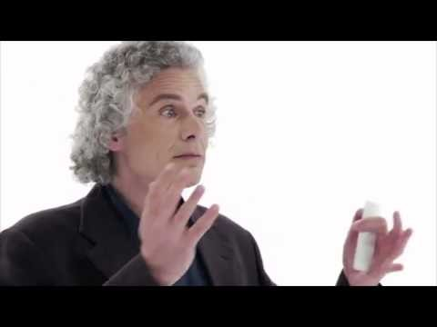
Prescriptive and Descriptive Rules
https://www.youtube.com/watch?v=kUiziVEoi1s

Slide 25
SPEAKING VS WRITING
Speaking (Natural)
  Started 2 million to 0.5 million years ago
  Learned from birth by most children
  Involves mostly descriptive rules
Writing (Artificial)
  Started 10 thousand years ago.
  Must be taught to every person
  Involves lots of prescriptive rules

Slide 26
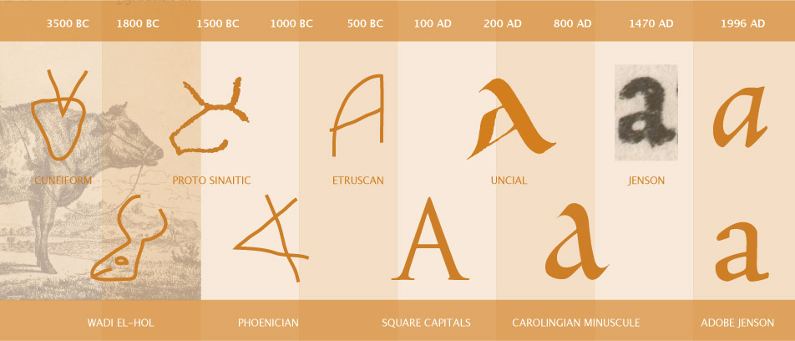
ORIGINS OF WRITING
  Ekur owes Shulgi two cows!

Slide 27
Homework Discussion
Exercise 2. p. 1.7
Pretend you’re working for a start-up that has developed a cool new product. Your company turns to you, the in-house linguist, to come up with a name for this new product. It has to be a unique name that doesn’t already exist.
What will you name your company’s cool new product?

Slide 28
Homework Discussion
Exercise 2. p. 1.7
Now, look at this list of product names generated by other students.
Which of them are good product names and which aren’t?
What makes something a good name?
How do you know?
mentocular swoodiei torrix baizan
jibberdab keerild euquinu tuitionary
kzen zirka hbiufk fluxon

Slide 29
Homework Discussion
Exercise 3. p. 1.7
One of the many ways that mental grammar is generative is that it is always possible to create new words in a language. English often allows the creation of new verbs from existing nouns, even from proper names like in the following sentences:
    We’re Megabussing to Montreal this weekend.
    You can find out the answer by Googling.
    The kids got Pfizered before going back to school.

Slide 30
Homework Discussion
Exercise 3. p. 1.7
Create three new verbs from English nouns (common nouns or proper names), and put each one in a sentence to illustrate its meaning.

Slide 31
Homework Discussion
Exercise 4. p. 1.7
Think of a word that has only recently entered English, so it’s not yet in mainstream dictionaries. Observe some examples of the word being used in context, either in your regular conversations or by searching online. Based on your observations of the word in context, write a dictionary definition of the word.

Slide 32
Homework Questions
At least three students share the questions they asked in the homework.
Let’s have an enlightening discussion of them!
We can continue to ask questions until 3:55

Slide 33
Homework Preview
Bonus: Letter of Introduction
  I prefer this now, but you can submit it any time for full credit.
Quiz Due on Friday at 5PM
  Covers Lectures, Syllabus, and Reading (Open Book)
  Can take a 2nd time (before 11:59 pm)
Essentials of Linguistics: 5 Morphology – Tuesday 11:59
  Scored based on completion
  Please number your answers!
  Ask a question!

Slide 34
Homework Preview
Morphology
  Morphology = Study of words and word parts
  Morpheme = a unit of sound that has a meaning
Types of Morphemes
  “Free” vs “Bound” Morphemes
  Roots vs Affixes
Introduction to Parts of Speech
  Linguistic definitions vs Semantic (meaning) definitions
  Form (morphology) vs Function (syntax)

Slide 35
End of Class
If you have questions or concerns, hang around to talk.
Please let me begin with folks with enrollment problems (waitlisted, might drop, etc).

